Slide 1

Dept. of Computer Science and Engineering BRAC University CSE 341 Team
8086 Hardware Specifications

Slide 2
Lecture References:
Book:
Microprocessors and Interfacing: Programming and Hardware, Author: Douglas V. Hall
The 8086/8088 Family: Design, Programming, And Interfacing, Author: John Uffenbeck.

Slide 3
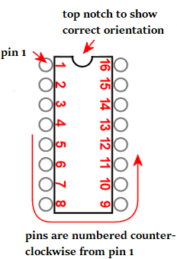
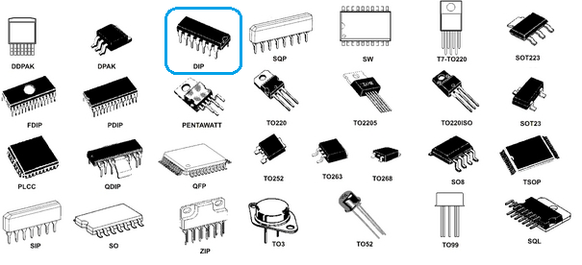
8086 Pin Specification
is a 40-pin DIPs; Dual in-line package
DIP refers to a rectangular housing with two parallel rows of electrical connection pins.
DIPs have a notch on one end to show its correct orientation.
The pins are then numbered as shown in the figure below.

Slide 4
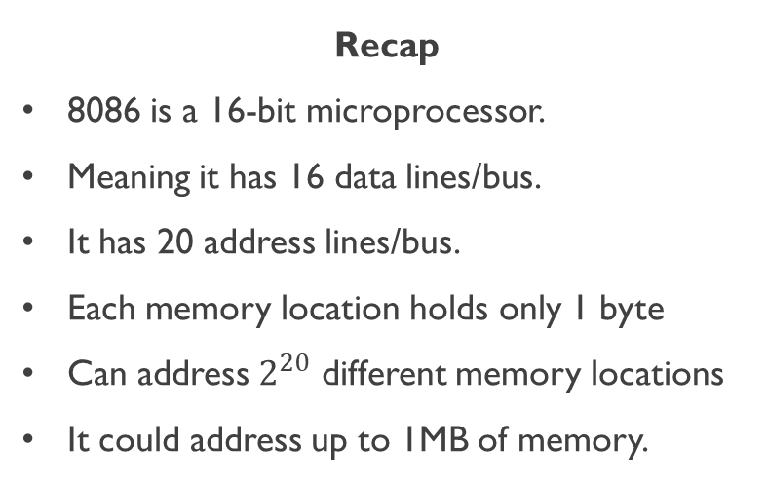
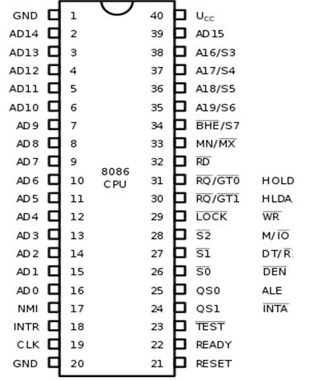
8086 Pin Diagram
min mode
max mode

Slide 5
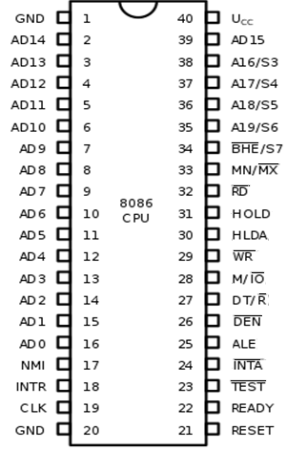
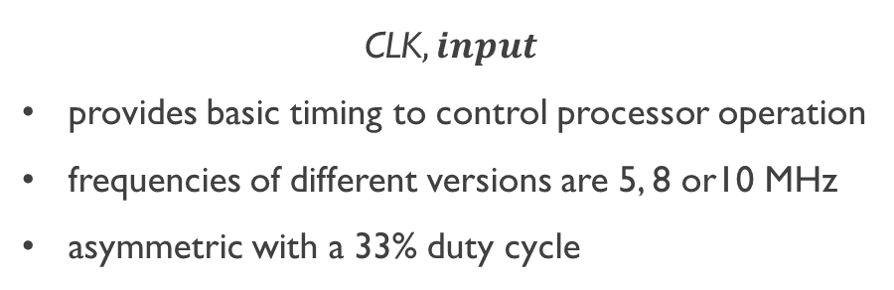
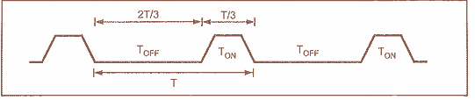
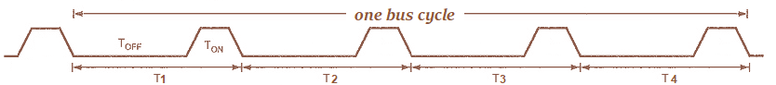
8086 Pin Specification

Slide 6
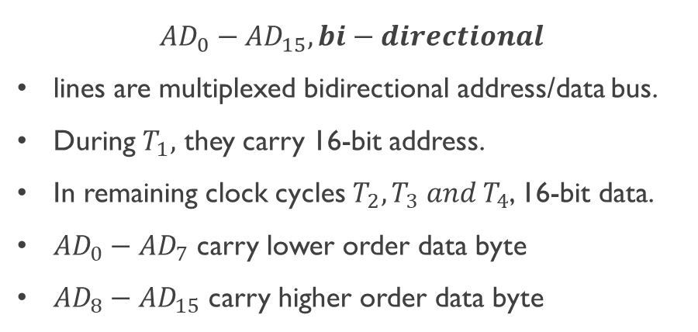
8086 Pin Specification

Slide 7
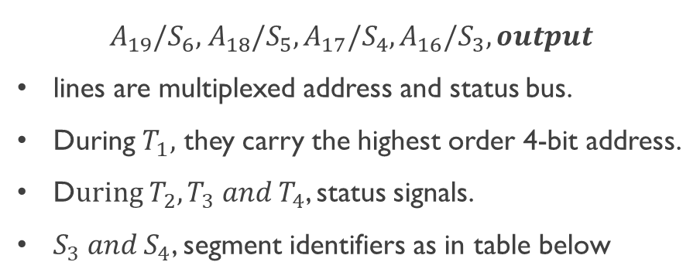
8086 Pin Specification
S4 | S3 | Function
0 | 0 | Extra segment access
0 | 1 | Stack segment access
1 | 0 | Code segment access
1 | 1 | Data segment access

Slide 8
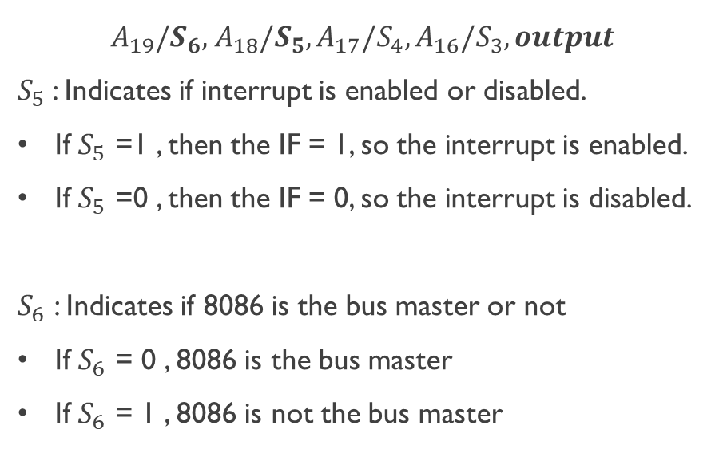
8086 Pin Specification

Slide 9
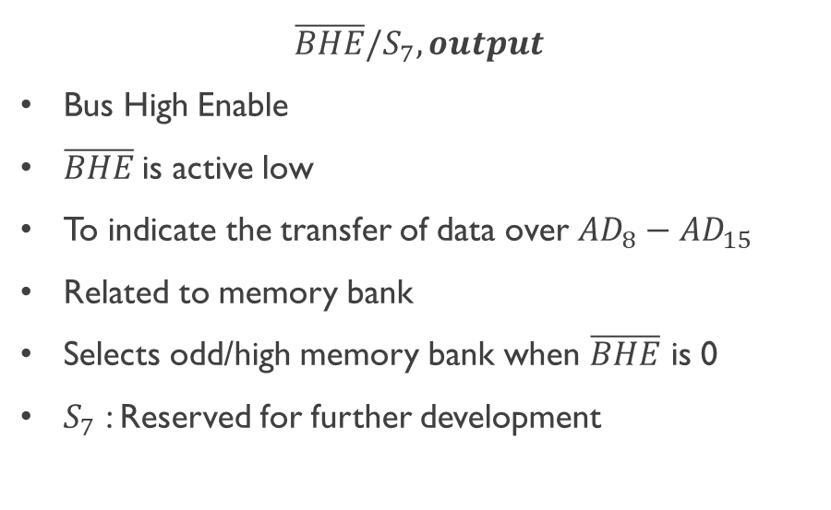
8086 Pin Specification

Slide 10
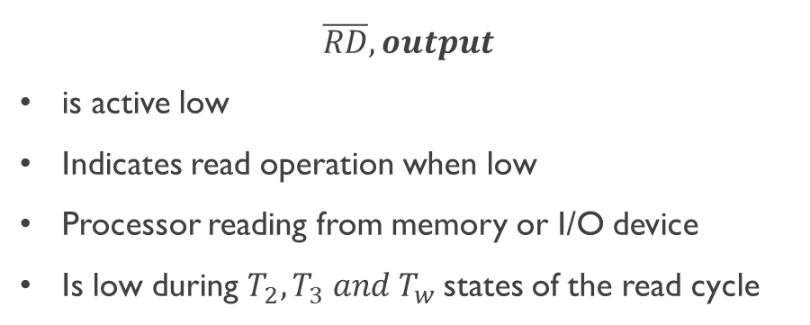
8086 Pin Specification

Slide 11
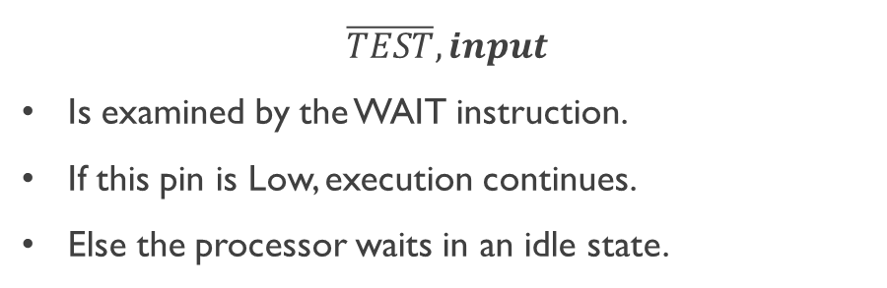
8086 Pin Specification

Slide 12
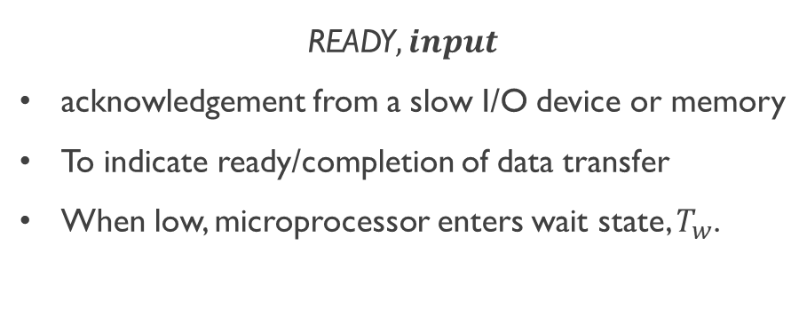
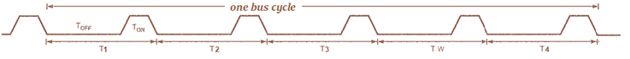
8086 Pin Specification

Slide 13
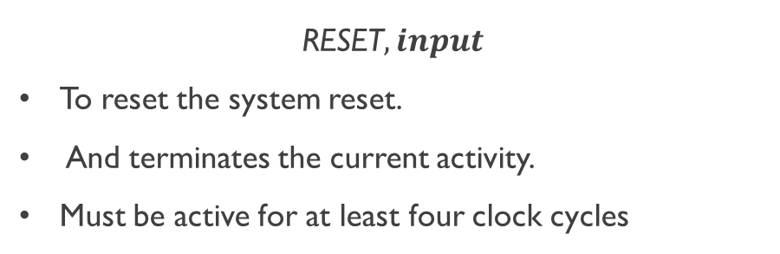
8086 Pin Specification

Slide 14
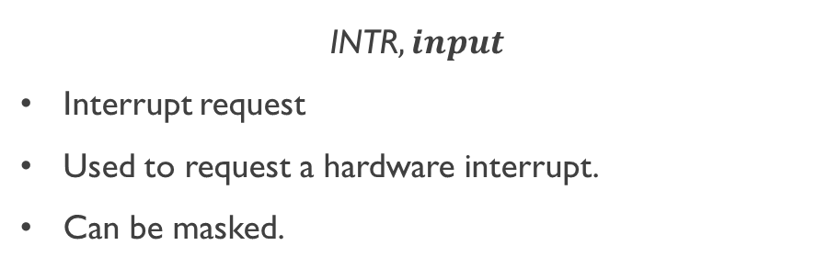
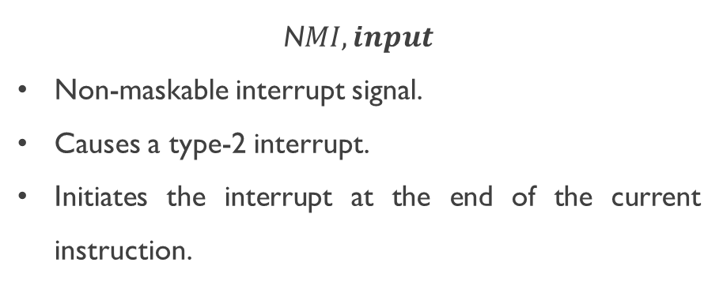
8086 Pin Specification

Slide 15
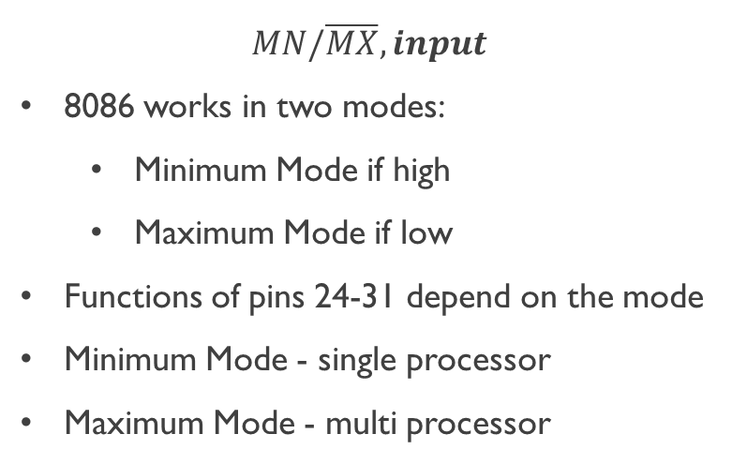
8086 Pin Specification
min mode
max mode

Slide 16

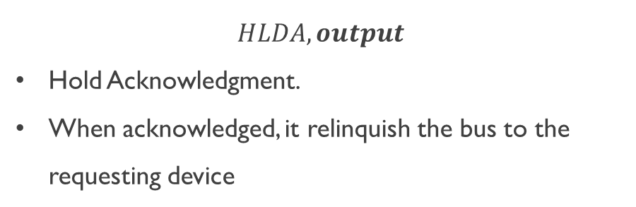
Minimum Mode Pin Specification

Slide 17
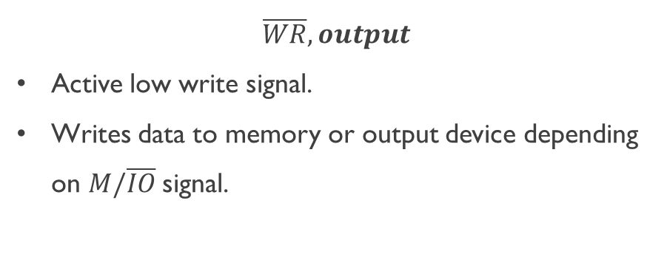
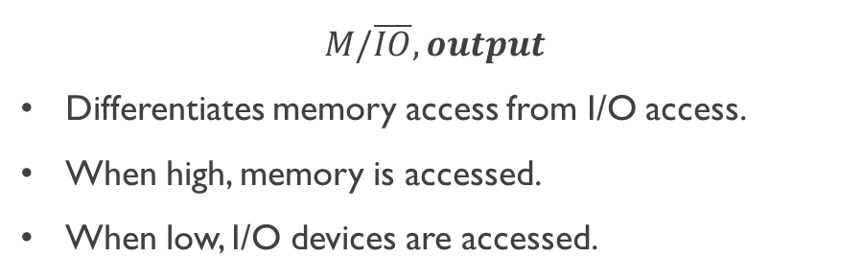
Minimum Mode Pin Specification

Slide 18
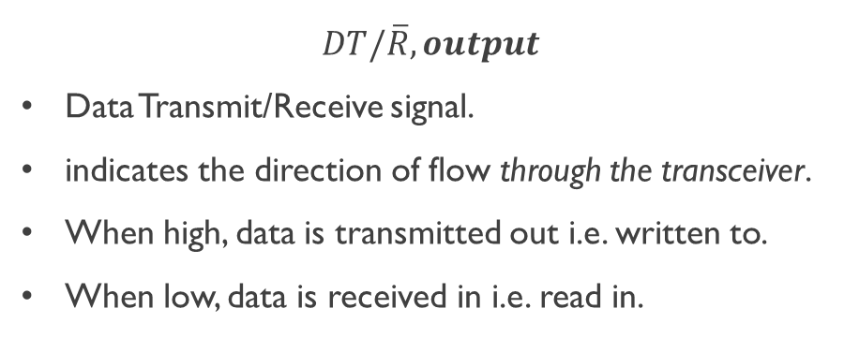
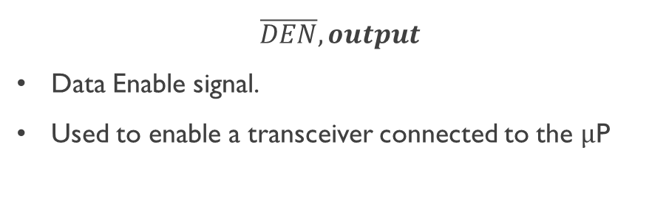
Minimum Mode Pin Specification

Slide 19
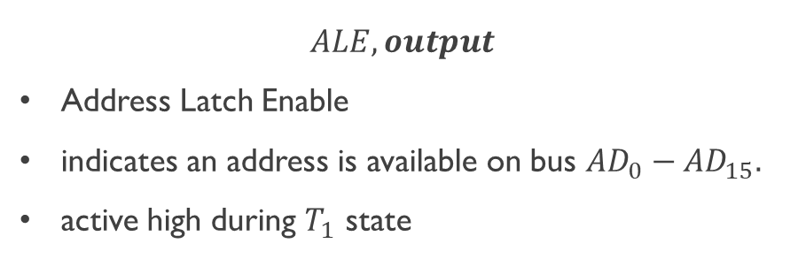
Minimum Mode Pin Specification

Slide 20
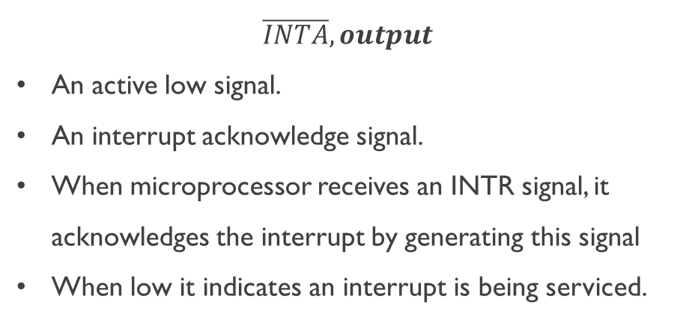
Minimum Mode Pin Specification

Slide 21
Dept. of Computer Science and Engineering BRAC University CSE 341 Team
8086 Maximum Mode Pins

Slide 22
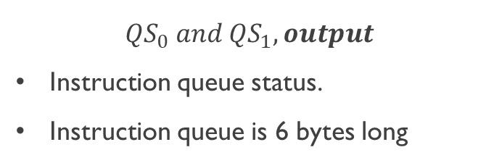
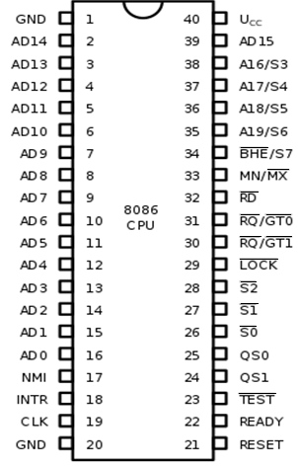
Maximum Mode Pin Specification
Qs1 | Qs0 | Function
0 | 0 | No Operation. During the last clock cycle, nothing was taken from the queue.
0 | 1 | First Byte. The byte taken from the queue was the first byte of the instruction.
1 | 0 | Queue Empty. The queue has been reinitialized as a result of the execution of a transfer instruction.
1 | 1 | Fetch subsequent byteSubsequent Byte. The byte taken from the queue was a subsequent byte of the instruction.

Slide 23
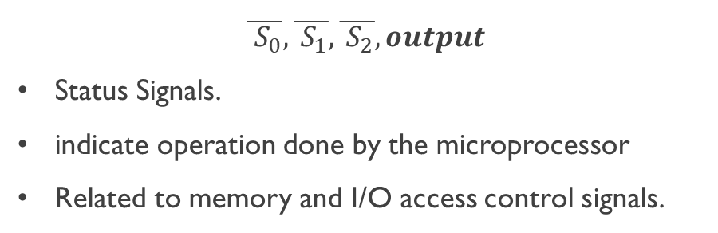
Maximum Mode Pin Specification
S2 | S1 | S0 | Function
0 | 0 | 0 | Interrupt acknowledgement
0 | 0 | 1 | Read data from I/O port
0 | 1 | 0 | Write data from I/O port
0 | 1 | 1 | Halt
1 | 0 | 0 | Opcode fetch
1 | 0 | 1 | Memory read
1 | 1 | 0 | Memory write
1 | 1 | 1 | Passive state

Slide 24
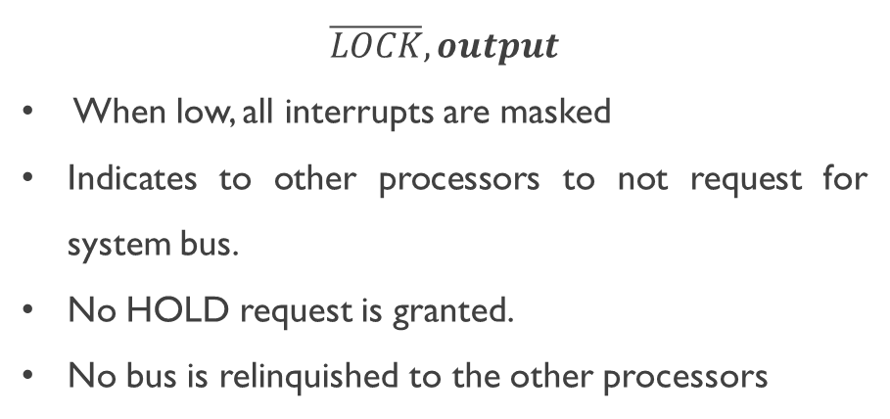
Maximum Mode Pin Specification

Slide 25
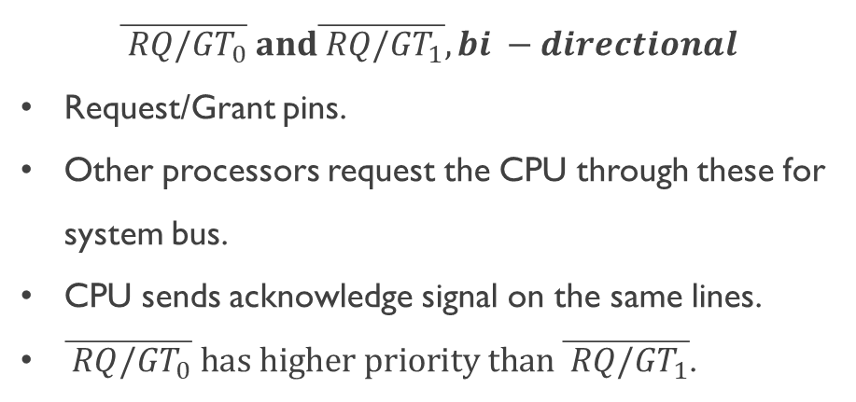
Maximum Mode Pin Specification

Slide 26
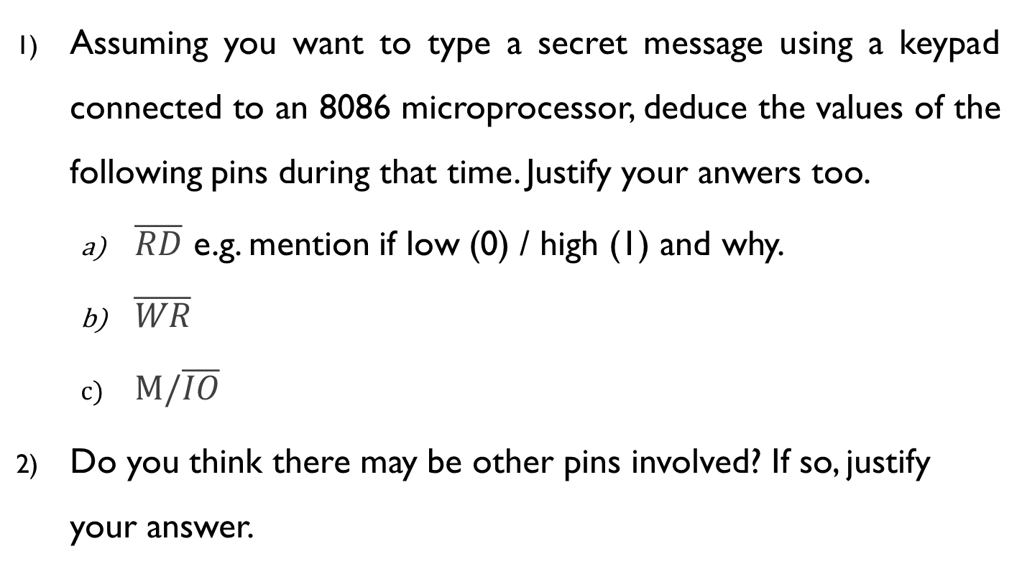
QUIZ

Slide 27
Dept. of Computer Science and Engineering BRAC University CSE 341 Team
8086 Clocks & Timing Diagrams

Slide 28
Microprocessor Operation
Fetch
Decode
Execute
An instruction e.g. MOV [7531h], AX ; SUB CH, [0ABCh] etc
The time a µP requires to complete fetch-(decode)-execute operation of a single instruction is known as Instruction Cycle

Slide 29
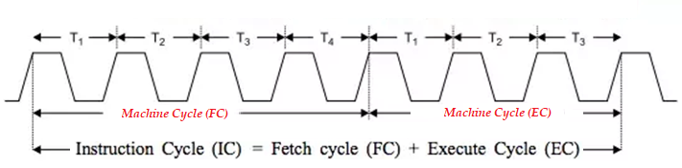
Microprocessor Operation
Instruction Cycle consists of one or more Machine Cycles
A basic µP operation such as reading/writing a byte from or to memory or I/O port is called a Machine/Bus cycle

Slide 30
Microprocessor Operation
A Machine (bus) cycle consists of at least four clock cycles, called T states.
One cycle of a clock is called a State
Each read or write operation takes 1 bus cycle.

Slide 31
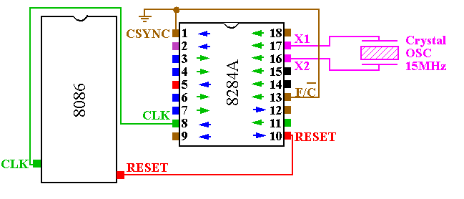
Clock Generation
Clock generator circuit is 8284A and connected to pin 19 (CLK) of 8086.

Slide 32
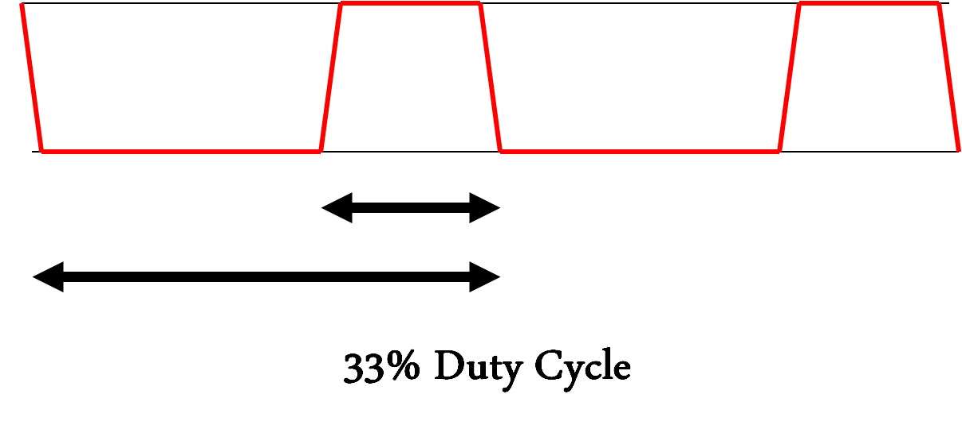


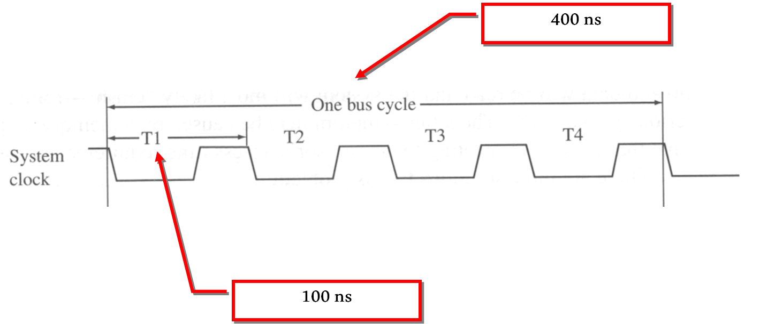
System Clock Concept
8086 is found to operate in between 5 to 10 Mhz.
An 8086 running at 5MHz, its clock pulses will be of 200ns and it would take 800ns for a complete bus cycle.
For a 10MHz 8086, its clock pulses will be of 100ns and it would take 400ns for a complete bus cycle.

Slide 33
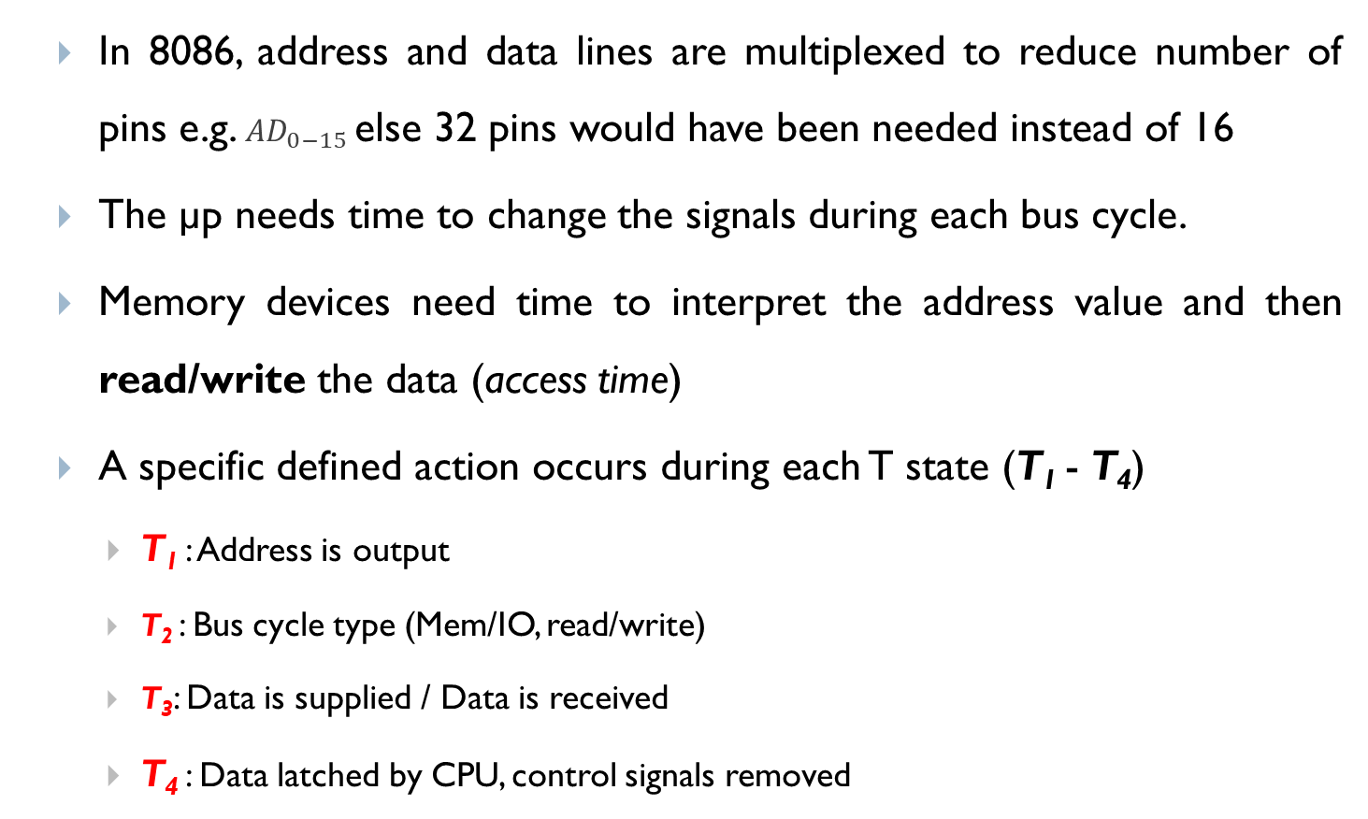
Clock States - Why are there T states?

Slide 34
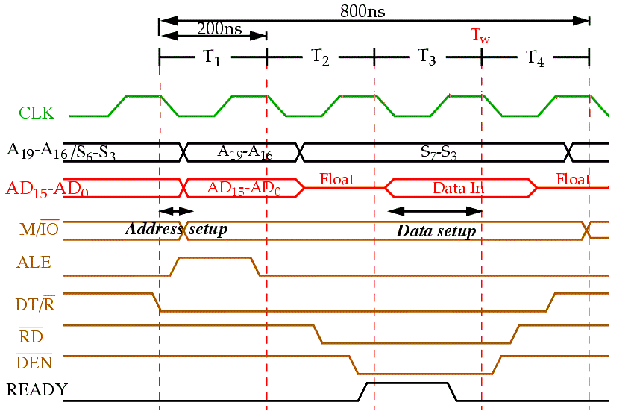
READ BUS Timing (Complete BUS Cycle)
T₁: Address is output
Address of memory is sent out by 8086 via address bus
Used Control signals: ALE, DT/R’, M/IO’ shows some output

Slide 35
READ BUS Timing (Complete BUS Cycle)
T₂: Bus cycle type (MEMORY/IO, READ/WRITE)
8086 issues either RD’ or WR’ and DEN’
In case of WRITE (WR) operation, data to be written appear on data bus

Slide 36
READ BUS Timing (Complete BUS Cycle)
T₃: Data is supplied
READY is sampled at the end of T2
If READY is low, T3 becomes a wait state (Tw), means no operation (NOP).
In READ bus cycle data bus is sampled at end of T3

Slide 37
READ BUS Timing (Complete BUS Cycle)
T₄: Data latched by µP, control signals removed
All bus signals deactivated in preparation for next bus cycle
µP sampled data bus for data that read from M or I/O

Slide 38
Clock States
A specific, defined action occurs during each T states (T₁ – T₄)
T₁: Address is output
Address of memory is sent out by 8086 via address bus
Used Control signals: ALE, DT/R’, M/IO’ shows some output
T₂: Bus cycle type (MEMORY/IO, READ/WRITE)
8086 issues either RD’ or WR’ and DEN’
In case of WRITE (WR) operation, data to be written appear on data bus

Slide 39
Clock States
T₃: Data is supplied
READY is sampled at the end of T₂
If READY is low, T₃ becomes a wait state (T_{w}), means no operation (NOP).
In READ bus cycle data bus is sampled at end of T₃
T₄: Data latched by µP, control signals removed
All bus signals deactivated in preparation for next bus cycle
µP sampled data bus for data that read from M or I/O
At trailing edge of WR’, transfer data to M or I/O

Slide 40
8086 Ready pin
The READY input is controlled to insert “Wait states” into the timing of the microprocessor for slower memory and I/O components..
If the READY pin is at a logic 0 level, the micro-processor enters into wait states and remains idle.
When it is high (logic 1), it indicates that the device is ready to transfer data.
A wait state is a situation in which a computer processor is waiting for the completion of some event before resuming activity.
A program or process in a wait state is inactive for the duration of the wait state.

Slide 41
Ready pin and Wait state
When a computer processor works at a faster clock speed than the random access memory ( RAM ) that sends it instructions, it is set to go into a wait state for one or more clock cycles so that it is synchronized with RAM speed. In general, the more time a processor spends in wait states, the slower the performance of that processor.
Wait states are a pure waste for a processor's performance. Modern designs try to eliminate or hide them using a variety of techniques: CPU caches, instruction pipelines, instruction prefetch, simultaneous multithreading and others.

Slide 42
Thank You
Questions are welcome in the discussion class

